Slide 1

Real-Time Video Adaptation in Virtualised 5G Networks
Research papers study by:
Hazilky Muna Putra M11302811
Jalu Veda M11302824

Slide 2
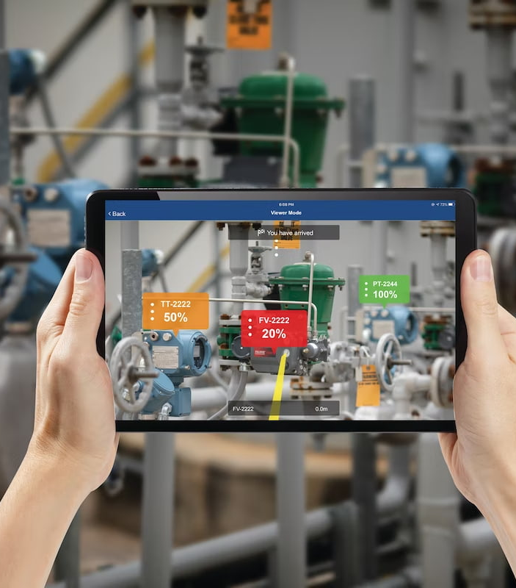
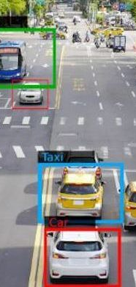
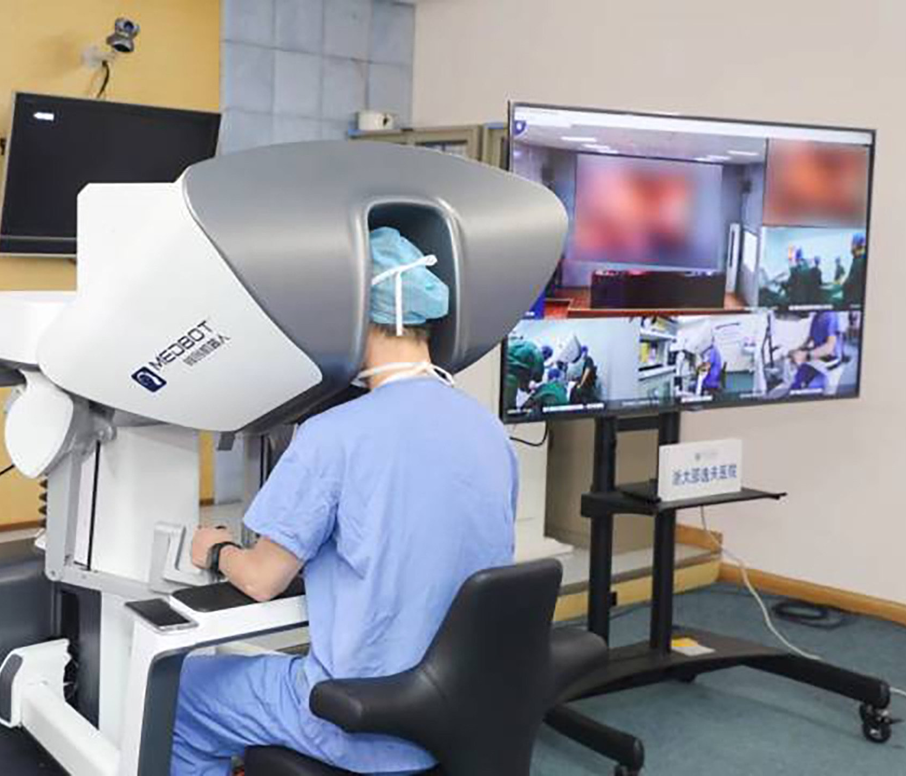
Introduction
Video streaming has dominated the network traffic
Causes heavy traffic load to the network and thus downgrades the overall performance in the 5G system

Slide 3
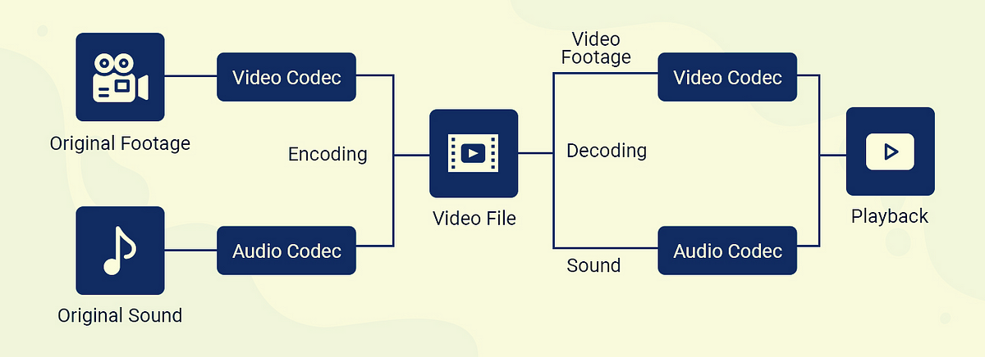
Existing video tools can hardly recognise 5G traffic or cope with the latest video codec (e.g., H.265/HEVC) in the virtualised 5G environment

Slide 4

It is essential to design a new video adapter with the ability to parse the 5G traffic and process video encoded by the latest codec

Slide 5
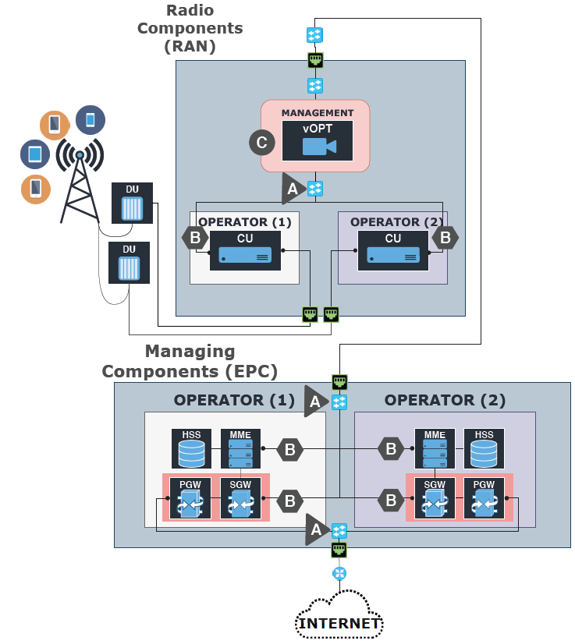
Virtualized 5G Infrastructure
Proposed vAdapter
Virtualized Long Term Evolution (LTE) based infrastructure
Allows a realistic analysis of video traffic in LTE-based 5G networks

Slide 6
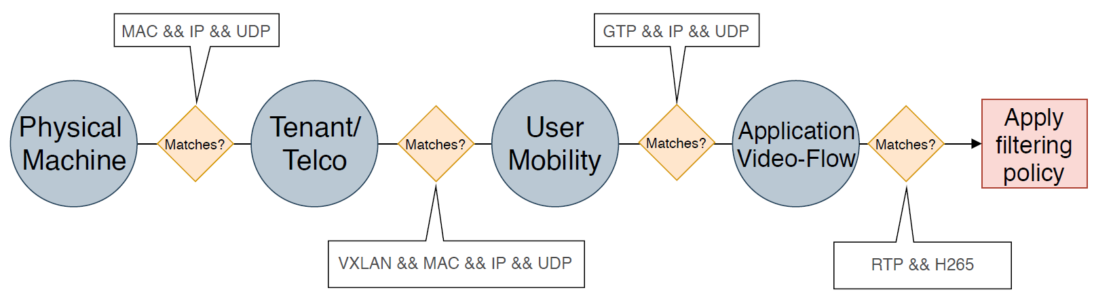
Video Traffic in 5G
The video adapter solution proposed in this paper leverages and adapts the existing filtering mechanism BPF (BSD Packet Filter)

Slide 7
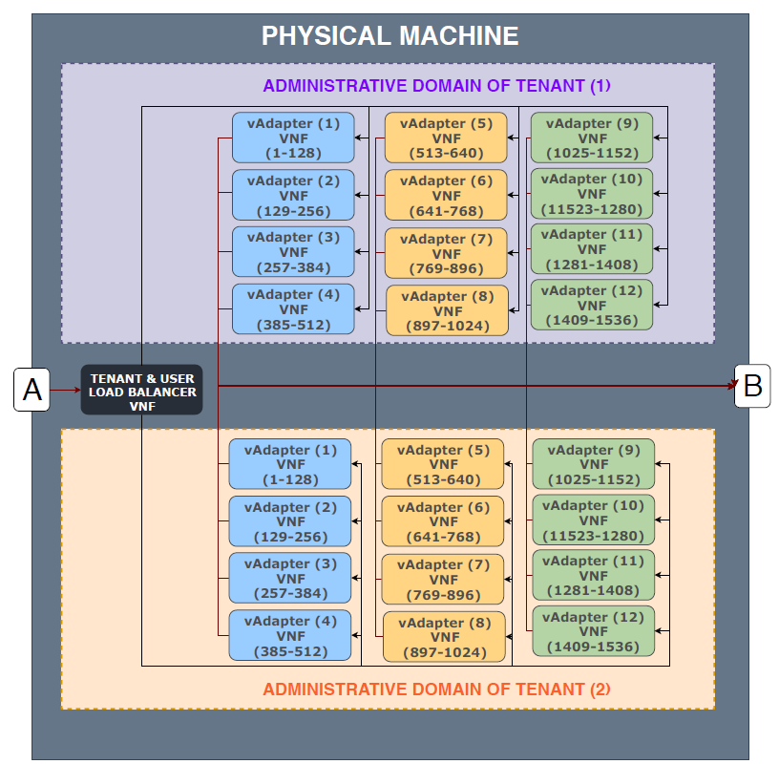
5G Testbed Implementation
128 is the advisable number of complex rules per vAdapterVNF without incurring packet loss or unacceptable delays/jitter
12 vAdapterVNFs were needed to cope with 1536 flows generated, each one holding up to 128 filtering rules, one per flow

Slide 8
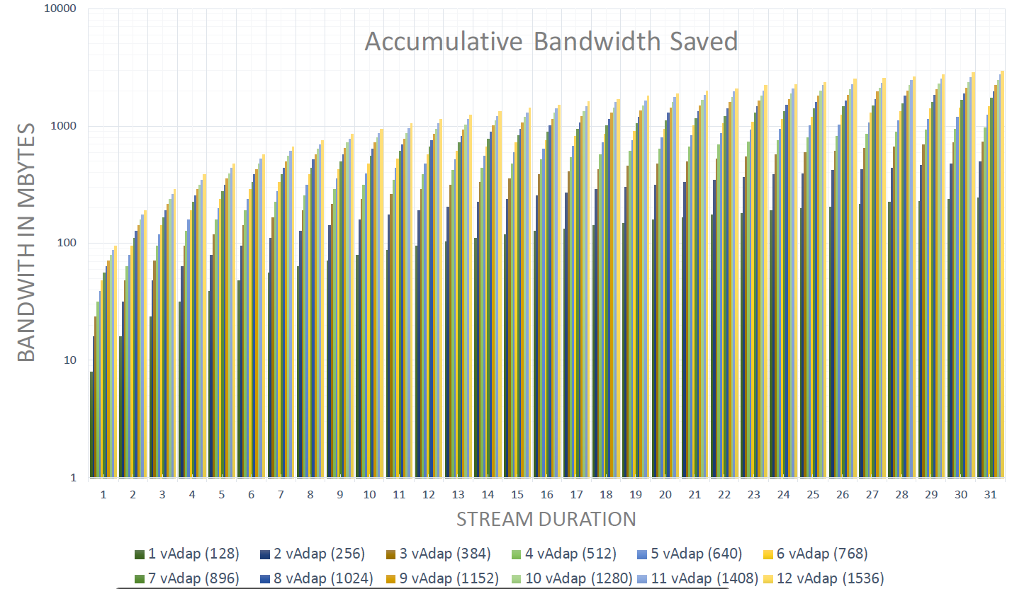
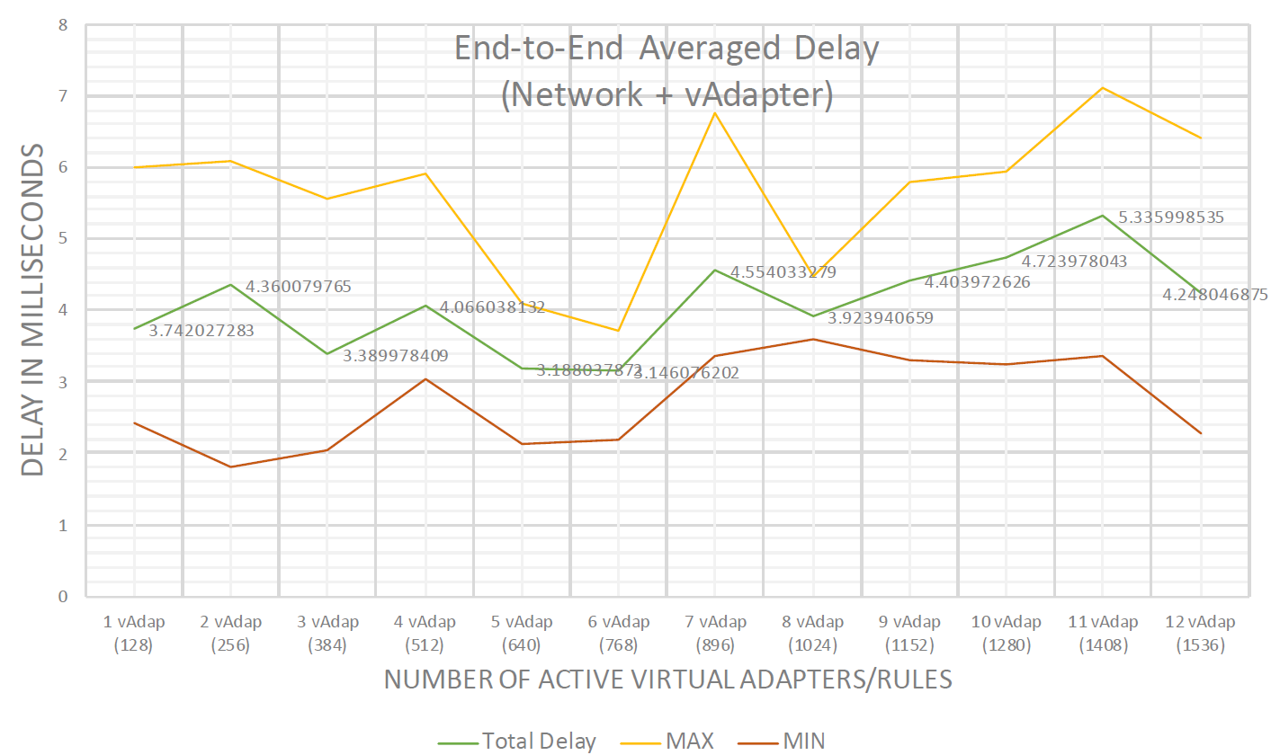
Results

Slide 9
Total delays are nearly constant even when the number of vAdapterVNFs are increasing
The additions of new vAdapterVNFs does not affect the end-to-end delay

Slide 10
Accumulative Bandwidth Saved per Second

Slide 11
Conclusion
Design and implementation of a new video adapter that is compliant with the latest video codec and can be flexibly deployed in virtualised 5G networks as a VNF (Virtual Network Function)
Proposed video adapter acts as a complete stack of VNFs to handle massive video traffic effectively
Proposed video adapter alleviates network congestion without compromising the quality of the services offered

Slide 12
References
P. Salva-Garcia, J. M. Alcaraz-Calero, Q. Wang, M. Barros and A. Gavras, "Real-Time Video Adaptation in Virtualised 5G Networks," 2019 IEEE 44th Conference on Local Computer Networks (LCN), Osnabrueck, Germany, 2019
O. Awobuluyi, J. Nightingale, Q. Wang and J. M. Alcaraz-Calero, "Video Quality in 5G Networks: Context-Aware QoE Management in the SDN Control Plane," 2015 IEEE International Conference on Computer and Information Technology; Ubiquitous Computing and Communications; Dependable, Autonomic and Secure Computing; Pervasive Intelligence and Computing, Liverpool, UK, 2015

